Slide 1

Asymmetric (Public)-Key Cryptography

Slide 2
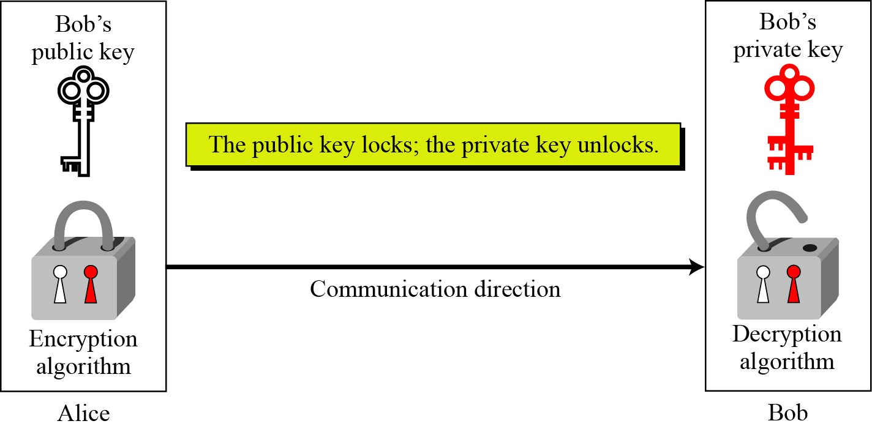
Asymmetric key cryptography uses two separate keys:
one private and one public.
Alice wants to send a message to Bob

Slide 3
Public – key cryptography - Procedure
Scenario:
Alice wants to send an encrypted message to Bob.
Procedure:
1. Bob computes a keypair (public and a private key).
2. Bob publishes his public key to Alice.
3. Alice Encrypts the message using Bob’s public key.
4. Alice sends the message to Bob.
5. Bob decrypts the message using his private key.

Slide 4
Plaintext/Ciphertext
Unlike in symmetric-key cryptography, plaintext and ciphertext are treated as integers in asymmetric-key cryptography.
Encryption/Decryption
C = E (K_{public} , P)
P = D(K_{private} , C)

Slide 5
RSA Algorithm:
Rivest – Shamir – Adleman developed in 1978.
It is an asymmetric cryptographic algorithm ( 2 keys - public key and private key)
Public key: known to all users in the network.
Private Key: Kept secret.
RSA contains 3 phases:
Key Generation
Encryption
Decryption

Slide 6
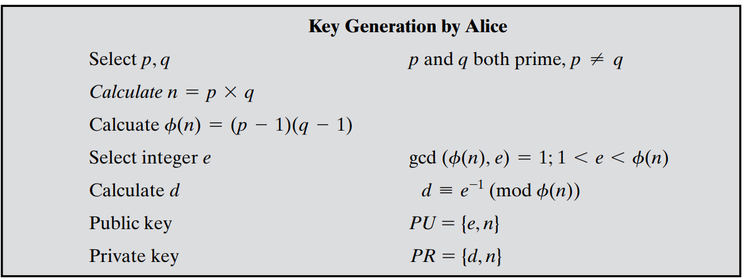
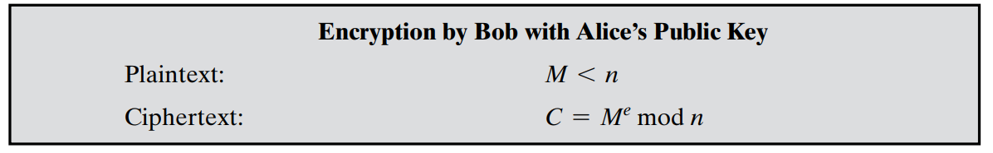
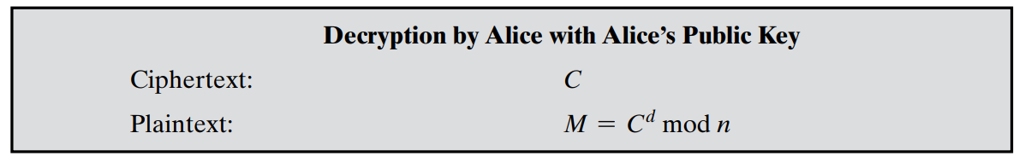

Slide 7
RSA Algorithm Steps
Step-1: Select two prime numbers ‘p’ and ‘q’ where p ≠ q.
Step-2: Calculate n = p * q.
Step-3: Calculate Ф(n) = (p-1) * (q-1).
Step-4: Select ‘e’ such that, ‘e’ is relatively prime to Ф(n),
i.e. gcd(e, Ф(n)) = 1 and 1 < e < Ф(n)
Step-5: Calculate d = e ⁻¹ mod Ф(n) or ed = 1 mod Ф(n).
Step-6: PU (Public key) = {e, n},
PR (private key) = {d, n}.
Step-7: Find out cipher text using the formula, C = P^{e} mod n
where, P < n where C = Cipher text, P = Plain text, e = Encryption key and n=block size.
Step-8: Plain text P can be obtain using the given formula, P = C^{d} mod n.
where, d = decryption key

Slide 8
Example
Step – 1: Select two prime numbers p and q where p ≠ q.
Example, Two prime numbers p = 13, q = 11.
Step – 2: Calculate n = p * q.
Example, n = p * q = 13 * 11 = 143.
Step – 3: Calculate Ф(n) = (p-1) * (q-1).
Example, Ф(n) = (13 – 1) * (11 – 1) = 12 * 10 = 120.
Step – 4: Select e such that, e is relatively prime to Ф(n), i.e. gcd(e, Ф(n)) = 1 and 1 < e < Ф(n).
Example, Select e = 13, gcd (13, 120) = 1.

Slide 9
Step – 5: Calculate d = e ⁻¹ mod Ф(n) or e * d = 1 mod Ф(n)
Example, Find ‘d’ to satisfy: (d *e)% Ф(n) = 1 ?
(d *13)% 120 = 1? (try d= 2,3,4………)
When d = 37, (37 *13)% 120 = 1
Therefore, d = 37

Slide 10
Step – 6: Public key = {e, n}, private key = {d, n}.
Example, Public key = {13, 143} and private key = {37, 143}.
Step – 7: Find out cipher text using the formula, C = P^{e} mod n where, P < n.
Example, Plain text P = 13. (Where, P < n)
C = P^{e} mod n = 13¹³ mod 143 = 52.
Step – 8: P = C^{d} mod n. Plain text P can be obtained using the given formula.
Example, Cipher text C = 52
P = C^{d} mod n = 52³⁷ mod 143 = 13.
Notes:
7 and 17
PT=6

Slide 11




Slide 12
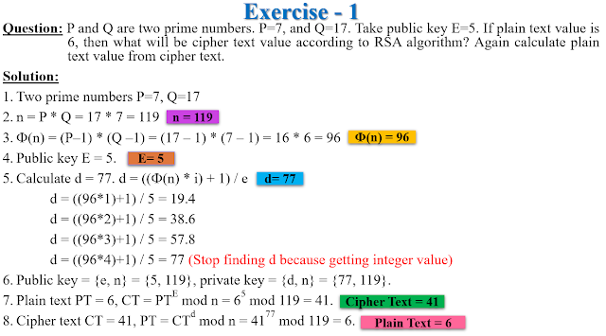

Slide 13
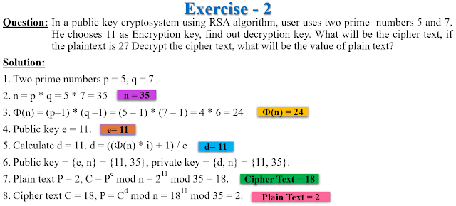

Slide 14
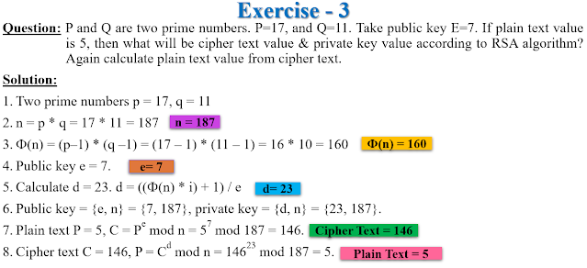

Slide 15
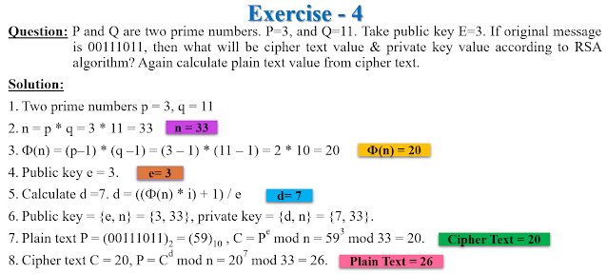

Slide 16
